Slide 1
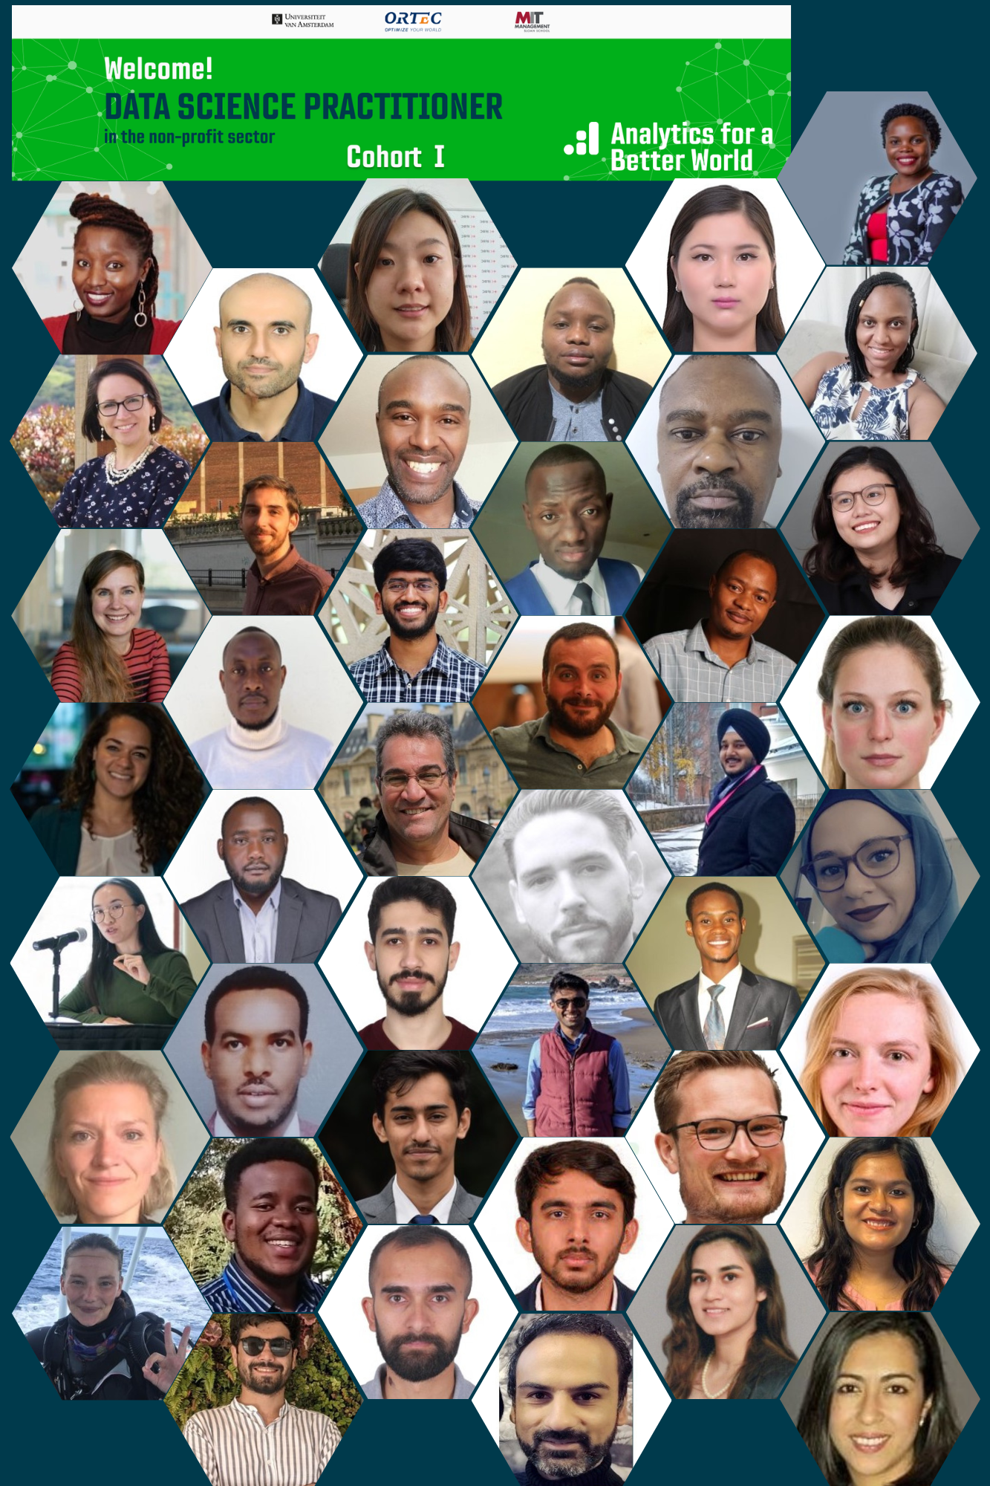
Data Science Practitioner Fellowship Cohort 2022
Final Project Presentation
Facility mapping for evidence-based planning of district's health programmes
Pratyush Sharma
Transform Rural India Foundation
Parvathy Krishnan K
6th December 2022

Slide 2
Business Case
Objectives:
Visualizing distribution of healthcare facilities in the district
Mapping the population catchment area
Analysing the accessible facilities to the population and identifying key junctures for effective service delivery of healthcare programs

Slide 3
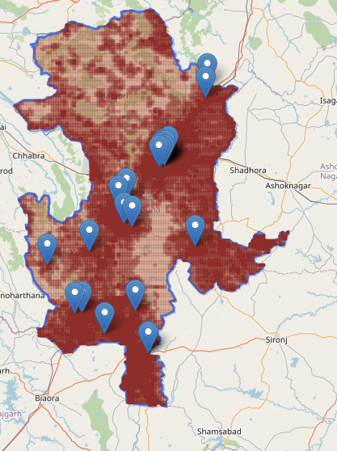
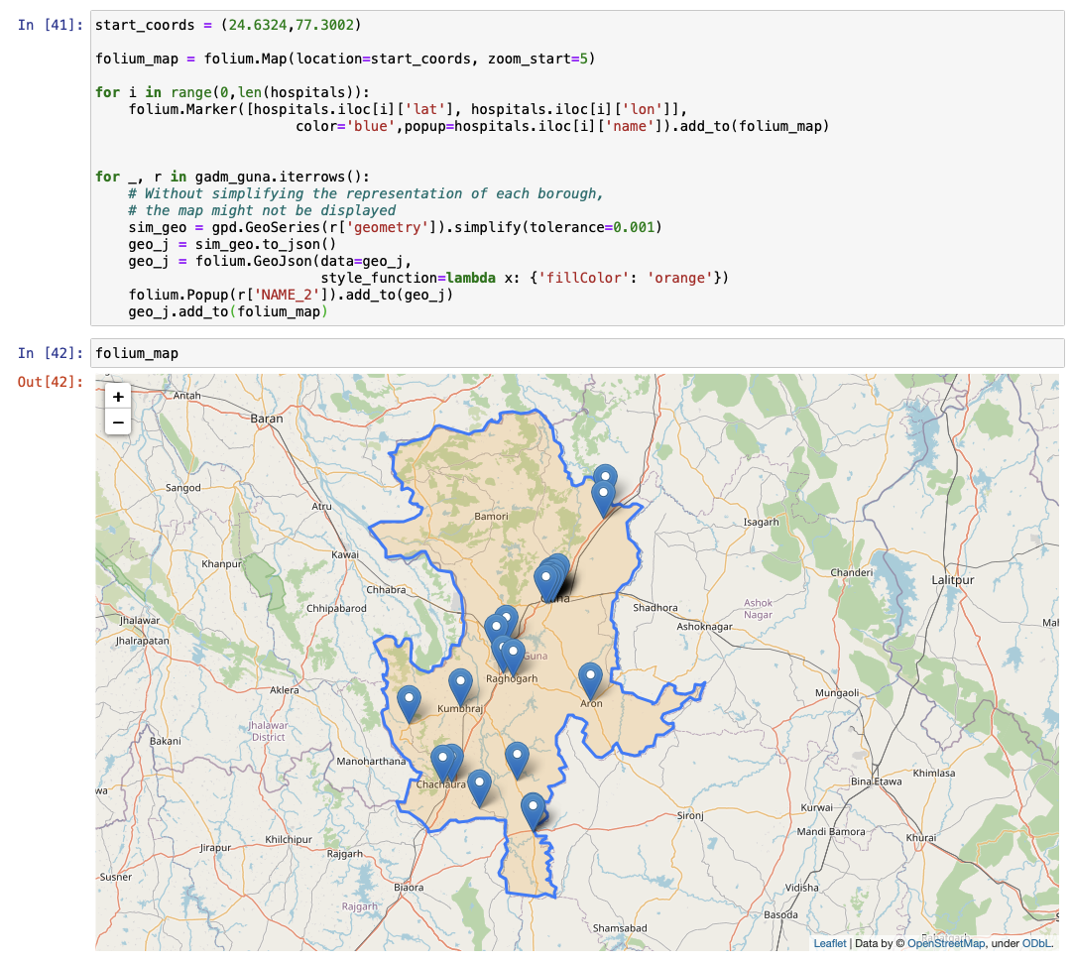
Methods or Tools Used
Tools - Jupyter Notebook (IDE)
Data Layers -
GADM (Database of Global Administrative Areas)
MapBox API
WorldPop

Slide 4
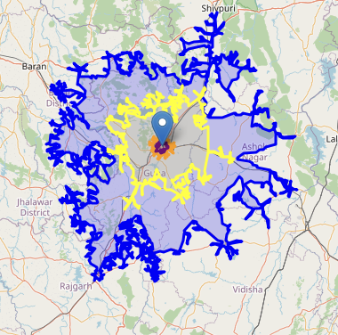
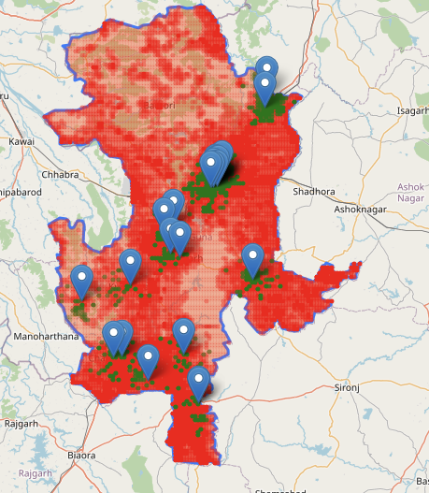
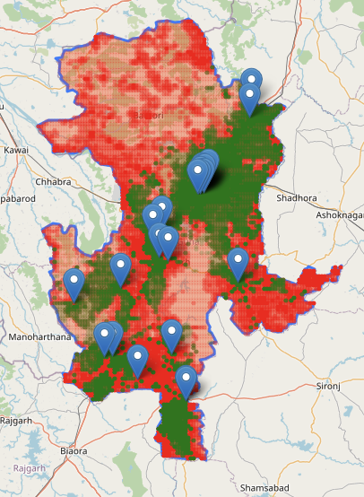
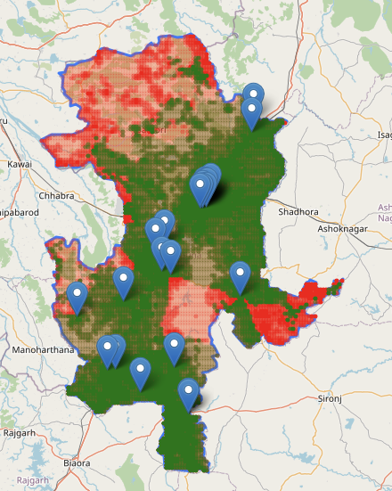
Graphic representing access to a healthcare facility within 5, 10 , 50 and 100 km
With and without access population at 10 km
With and without access population at 25 km
With and without access population at 50 km
With and without access population at 10 km
SN | Distance from nearest healthcare facility (in km) | Percentage of population
1 | 5 | 12%
2 | 10 | 20%
3 | 25 | 50%
4 | 50 | 81%
5 | 100 | 100%

Slide 5
Most Significant Change
The results of the project will be help the administration in the following areas;
Identifying the key junctures for -
Organizing healthcare camps
Initiation of the IEC activities
Identifying new infrastructure demanding areas

Slide 6
Key Learnings
Version control systems
EDA and data visualization tools
Choosing the right data visualizations to enhance understanding and effective decision making
Stakeholder engagement: Getting stakeholders on board with your project
Interesting applications of Geo-spatial data analysis
Pedestrian fatality data analysis
Environment: Water body monitoring, tracking forest cover
Agriculture: Farm boundary detection, crop pattern monitoring
Industry/Government: Land use classification, Asset tracking and management

Slide 7
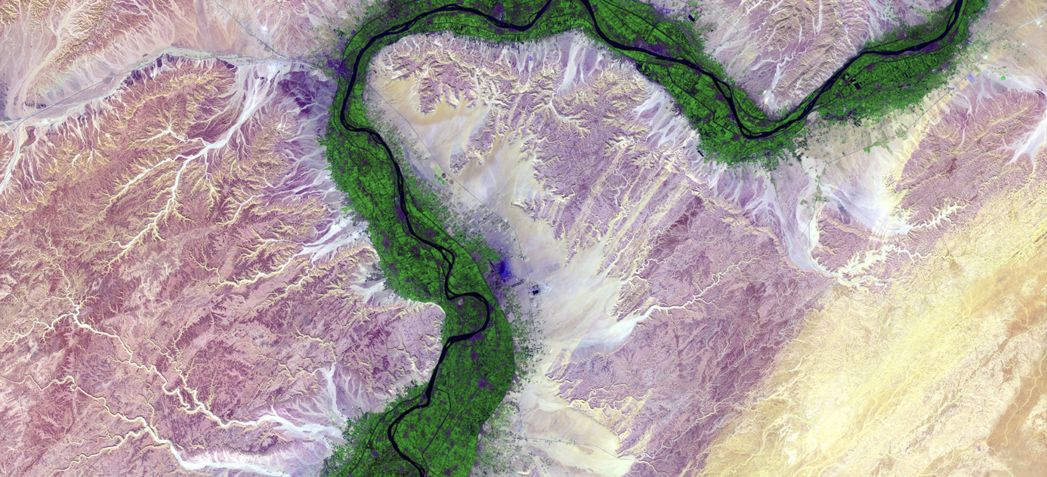
Thank you for your attention!
https://analyticsbw.org/
https://www.linkedin.com/company/analytics-for-a-better-world/
academy@analyticsbetterworld.org

